Slide 1

CS331 PLL
LISP Programming
Session by:
Prof. Pradip K.Das

Slide 2
Lisp: An Introduction
Lisp – List Processing language
Developed by John McCarthy, MIT, in the late 1950s
The original idea was to implement a language based on mathematical functions that McCarthy was using to model problem solving.
A grad student implemented the first interpreter, and it was quickly adopted for AI programming:
Symbolic computing
List processing
Recursion
Early Lisp was based almost entirely on recursive and so
Lisp had no local variables nor iterative control structures (loops)
and since Lisp was interpreted, there was no compiler for early Lisp

Slide 3
More on LISP
In part because this was early in the history of high level languages, and in part because of the desire to support AI
LISP used dynamic scoping
LISP had no compiler
LISP had no local variables
LISP was slow
But, because LISP was interpreted
It was easy to prototype systems and build larger scale systems than a compiled language
Lisp had features not available in other early languages
Recursion
Linked lists
Dynamic memory allocation
Typeless variables

Slide 4
Lisps, Lisps and More Lisps
The original Lisp was both inefficient and difficult to use
Other Lisp dialects were released by people trying to further the language
They added a compiler, local variables, static scoping, etc.
While Scheme is the most recognized Lisp to come out of these efforts, others include Qlisp, Elisp, Interlisp, etc.
Specialized hardware was manufactured to support Lisp:-
Hardware that had large heap memory spaces and optimized routines for garbage collection.
Interestingly, the first GUI was implemented for Lisp machines.

Slide 5
Toward a Standard: Common Lisp
DARPA sponsored an effort in the early 1980s to develop a standard for lisp, and so Common Lisp (CL) was born
However, among the Lisp community, there were hard-fought battles
West coast users often used Interlisp.
East coast users often used MACLisp.
CL would take the best attributes found in MacLisp with some influence from Zetalisp, Scheme and Interlisp.
It would also provide a number of imperative features (e.g., loops)
ANSI created a standard for CL around 1990
The Common Lisp Object System (CLOS) was added to CL making the language roughly equivalent in size and capability to C++
While not as recognized as C++, Common Lisp is a very useful and flexible language.

Slide 6

Goals of CL
Commonality – a common dialect of Lisp for which extensions (for given hardware) should be unnecessary
Portability and Compatibility
Consistency – prior Lisps were internally inconsistent so that a compiler or interpreter might assign different semantics to a correct program
Expressiveness and Power
Efficiency – for instance, optimizing compilers and instructions that perform efficient operations on lists
Stability – changes in CL will be made only with due deliberation

Slide 7
Some CL Uses
CL is a very successful language in that
It is extremely powerful as an AI tool
And yet CL is a very uncommon language because
It is very complicated
most software development is in C++ (with some in Java, C#, C, Python, Ada, etc.) such that few programmers would choose to use CL for development
The most important software developed from CL includes:
Emacs
G2 (a real-time expert system)
AutoCAD
Igor Engraver (musical notation editor and publisher)
Yahoo Store
Up until the early 1990s, most AI research was still done in Lisp, most using Common Lisp
However, once C++ added objects, many researchers switched to C++ because
Their graduate students had more familiarity with C++
Obtaining C++ compilers is often cheaper and easier than CL compilers and environments
C++ programs will run faster than CL programs (not always true, but generally true)

Slide 8
Why Study CL?
Learn about
Learn about functional programming
Learn
Learn how to utilize recursion better
Learn about
Learn about symbolic computing
Gain
Gain experience in other languages and syntax
Get
Get a better idea of such concepts as scope, binding, memory allocation, etc.
Learn
Learn a little about AI problem solving
Learn
But primarily: learn a new language
One that is very very different from what you have already experienced
But also a very rich and complex language

Slide 9
Lisp Basics
Everything in a Lisp program is either
An atom
A single literal value which could be:
a number
a symbol like ’hello’
not to be confused with a string, a symbol cannot be subdivided in any way
a character
T or nil
A list
Lists are denoted by ( )
Lists can contain nothing (empty list), one or more atoms, sublists, or some combination of these
In Lisp, all variables are pointers that point to an atom or a list, but like Java, these pointers do not need dereferencing (unlike C or C++)
There are also sequences of different types (vectors, arrays, strings, structures, objects), these are neither lists nor atoms

Slide 10
Variables, Lists, Pointers
All variables are in fact pointers
A variable’s pointer points to an item in heap memory
like Java, there is no dereferencing (unlike C or C++)
unlike Java, all items are pointed to whether they are objects, strings, arrays, numbers, atoms, whatever
Lists are not only pointed to by the variable that defines the list, but each list element contains a pointer to the next item
The structure of a list item is actually two pointers
the CAR is the pointer to the item
the CDR is the pointer to the next list item
this structure looks like this
This structure is known as a cons cell
CDR
CAR

Slide 11
Lisp Code vs. Data
Lisp code is placed inside of lists
All* Lisp instructions are function calls
All Lisp function calls are written in prefix notation (name param1 param2 …)
All Lisp function calls return a value, which can be used in another call
example: (square (+ 3 5)) → (+ 3 5) returns 8, (square 8) returns 64
Lisp data are most commonly placed in lists
So in Lisp, data and code have the same look to them, this makes it easy to write code that manipulates code rather than data (code that can generate code for instance)
* - there are exceptions to this statement that we will explore throughout this course

Slide 12

Lisp Interpreter
One of the more unique aspects of Lisp (as opposed to say Java or C) is that it is an interpreted language
You are given a command line where you can type in commands where a command can be
a single executable statement (e.g., (+ x y))
a definition (defining a new function, defining a variable, defining a class, instantiating an object, etc)
you see the response immediately and you don’t have to have already compiled anything, this lets you test out code while you write it
The Interpreter works on a REPL cycle:
Read – read the latest item typed in at the command line (ended by <enter>)
Eval – evaluate what was typed in (execute it)
Print – print the result to the screen for immediate feedback
Loop – do it all over again
Note: you can type definitions and instructions in an editor and load it all at once or compile it and load the compiled file

Slide 13


Examples
Let us write an s-expression to find the sum of four numbers 17, 91 ,12 and 45. To do this, we can type at the interpreter prompt.
(write (+ 17 91 12 45))
Output:
2. Printing on console:
(write-line "Hello this is Prof. Pradip K. Das")
(write-line "Welcome to CS331")
Output:

Slide 14
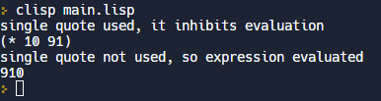
Examples
Use of Single Quotation Mark
(write-line "single quote used, it inhibits evaluation")
(write '(* 10 91))
(write-line " ")
(write-line "single quote not used, so expression evaluated")
(write (* 10 91))
Output:

Slide 15
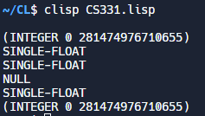
LISP- Data types
In LISP, variables are not typed, but data objects are.
LISP data types can be categorized as:-
Scalar types − for example, number types, characters, symbols etc.
Data structures − for example, lists, vectors, bit-vectors, and strings.
(defvar x 10)
(defvar y 34.567) Output:
(defvar ch nil)
(defvar n 123.78)
(defvar bg 11.0e+4)
(defvar r 124/2)
(print (type-of x))
(print (type-of y))
(print (type-of n))
(print (type-of ch))
(print (type-of bg))
(print (type-of r))

Slide 16
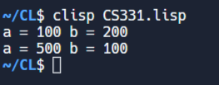
Variables
Since there is no type declaration for variables in LISP, you directly specify a value for a symbol with the setq construct.
The symbol-value function allows you to extract the value stored at the symbol storage place.
(setq x 100)
(setq y 200)
(format t "a = ~2d b = ~2d ~%" x y)
(setq x 500)
(setq y 100)
(format t "a = ~2d b = ~2d" x y)
Output:

Slide 17
Example Session with REPL
CL-USER 1 > 'hello
HELLO
CL-USER 2 > (print 'hello)
HELLO
HELLO
CL-USER 3 > (setf a 'hello)
HELLO
CL-USER 4 > a
HELLO
CL-USER 5 > 'a
A
Type in a statement, it is evaluated
’hello evaluates the symbol hello
print is a function, it prints the item and
also returns the item
setf is a function that has a side effect of
adjusting a pointer and returns the value
that the pointer is pointing to
evaluate a returns what a points to
notice here the quote mark says “do not
evaluate, just return”

Slide 18
Example Session
CL-USER 41 > (defun sortlist (lis)
(let (temp (size (length lis)) (sortedlist nil)
(currentmin 1000))
(dotimes (i size)
(setf temp (findmin lis))
(if (< temp currentmin) (setf currentmin temp))
(setf lis (remove temp lis))
(setf sortedlist (append sortedlist (list temp))))
sortedlist))
SORTLIST
CL-USER 42 > (sortlist '(5 3 4 7 2 1 6))
(1 2 3 4 5 6 7)

Slide 19
The Debugger
Unfortunately, the run-time environment is where most of your errors will be caught
Every time the interpreter does not understand something, you are thrown into the debugger
For now though, we will simply abort out of the debugger any time an error arises
This differs from implementation to implementation, but in LispWorks, look at the options and then type c: # where # is the number of the abort option (for instance, c: 1)

Slide 20
Example With Debugger
CL-USER 43 > (sortlist b)
Error: The variable B is unbound.
1 (continue) Try evaluating B again.
2 Return the value of :B instead.
3 Specify a value to use this time instead of evaluating B.
4 Specify a value to set B to.
5 (abort) Return to level 0.
6 Return to top loop level 0.
Type :b for backtrace, :c <option number> to proceed, or :? for other options
CL-USER 44 : 1 > :c 3
Enter a form to be evaluated: '(5 3 2 4 1)
(1 2 3 4 5)

Slide 21
Example Continued
CL-USER 62 : 1 > (sortlist b)
Error: The variable B is unbound.
1 (continue) Try evaluating B again.
2 Return the value of :B instead.
3 Specify a value to use this time instead of evaluating B.
4 Specify a value to set B to.
5 (abort) Return to level 1.
6 Return to debug level 1.
7 Return a value to use.
8 Supply a new first argument.
9 Return to level 0.
10 Return to top loop level 0.
Type :b for backtrace, :c <option number> to proceed, or :? for other options
CL-USER 63 : 2 > :c 4
Enter a form to be evaluated: '(5 3 4 6 2 1)
(1 2 3 4 5 6)

Slide 22
Example Continued
CL-USER 66 > (sortlist)
Error: Call ((LAMBDA (#:LIS) (DECLARE (SPECIAL:SOURCE #)
(LAMBDA-NAME SORTLIST))
(BLOCK #:SORTLIST (LET # # #:SORTEDLIST)))) has the
wrong number of arguments.
1 (abort) Return to level 0.
2 Return to top loop level 0.
Type :b for backtrace, :c <option number> to proceed, or :? for other options
CL-USER 67 : 1 > :b
Interpreted call to SORTLIST
Call to SPECIAL::%EVAL-NOHOOK
Call to IV:PROCESS-TOP-LEVEL
Call to CAPI::CAPI-TOP-LEVEL-FUNCTION
Call to CAPI::INTERACTIVE-PANE-TOP-LOOP
Call to (SUBFUNCTION MP::PROCESS-SG-FUNCTION
MP::INITIALIZE-PROCESS-STACK)

Slide 23
Defining Functions
There are a number of built-in functions in CL
The basic form is:
(defun name (params) body)
name is the name of your function to have, it can be any legal CL name (and as long as the name is not a pre-defined CL name but it can be a name that you had previously used yourself)
params are the names of parameters being passed into the function, they can be any legal name, and there are no types associated with them in the definition, the list can be empty as in ( )
body is one or more CL function calls, after the last one is called, whatever value that last function call returns is returned by this function

Slide 24
Lisp and Variables
There are generally three kinds of variables
Global variables – defined in the run-time environment (at the command line) or outside of a function in a file
these can be accessed within a function, but only having been declared as special
Local variables – defined in a function using the let statement, or within the scope of a specific instruction, such as the loop counter(s) in a do statement
these can only be accessed inside their scope, as soon as their scope ends, you can no longer access them
Parameters – much like local variables, but they are available throughout the entire function

Slide 25
Variable Types
As described earlier, variables are actually pointers, but unlike C, the pointers are not typed
This means that the value being pointed to by a pointer can be of one type and later the pointer can point to a value of another type
With a few exceptions, variables in CL are not typed
notable exceptions to not typing variables are objects and structures
However, all variables are type checked at run-time to make sure that a value is being treated correctly
So (* 5 ’a) will yield a run-time error rather than an incorrect value

Slide 26
Operations on Numbers
Arithmetic functions:
+, -, *, /
Note that / will always return quotient and remainder, there is nothing equivalent to “integer division” as we see in Java
But there are functions for truncate, round, ceiling, floor and mod
(truncate 5 3) → 1 (equivalent to 5 / 3)
(mod 5 3) → 2 (equivalent to 5 % 3)
Common Lisp will always reduce fractions as much as possible, so (/ 6 8) → ¾ and (/ 6 2) → 3
Now consider: (+ #c(3 5) #c(2 1)) → #c(5 6)
But (* #c(3 2) #c(3 -2)) → 13, why?
Comparison functions:
<, >, =, /=, <=, >=
EQL is similar to = but more restrictive, it says “numbers must be equal and be the same type”
(= 5 5.0) is T, (EQL 5 5.0) is nil

Slide 27
Preventing Evaluation
One problem in Lisp is that everything entered at the command line is evaluated
(+ 3 5) → evaluate +, apply it to the evaluation of 3 and 5
(+ a b) → evaluate +, apply it to the evaluation of a and b
a and b are variables, so evaluating a returns the value it points to (if a = 5 and b = 4, then (+ a b) returns 9)
(length lis) – returns the number of elements in lis
What if lis is not a variable, but the list (a b c)?
(length (a b c)) → this does not return 3, instead it will probably cause an error because (a b c) is interpreted as “call function a passing parameters b and c”

Slide 28
Basic I/O
CL has very powerful I/O facilities
However, to get started, we will look at two simple I/O operations:
(read) – get the next input from the keyboard and return it
(setf x (read)) ;; accepts one input and stores it in x
(print x) – sends x to the run-time window, but only works on a single item
if you want to print multiple items, put them in a list as in
(print (list x y z))
Note: this output will look like this: (5 3 1) rather than 5 3 1
Later on, we will examine formatted input and output, inputting from other sources, outputting to different windows, and file I/O

Slide 29
Putting It All Together
We will rely heavily on the REPL interpreter
Start up Common Lisp
Type in a function, if it is interpreted correctly, there will be no error
Now you can call your function to test it out
If it isn’t right, redefine it with another defun statement
Evolve your code over time
Alternatively, type your code into an editor
This allows you to write your code as a series of functions so that you can get a more global idea of what you have to do, and save your code in a text file
Copy and paste your code from the editor into the interpreter
Or, save the file and load the entire file at one time (usually you will only do this after you know all of your individual functions work!)

Slide 30
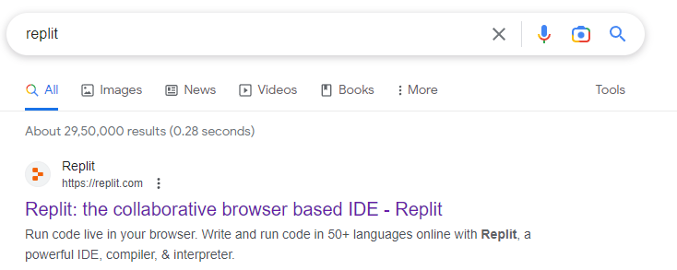
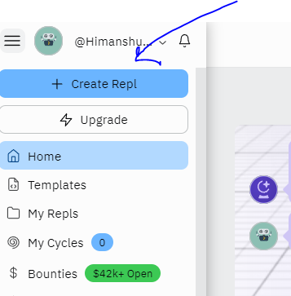
Environment
STEP 1: Online IDE
STEP 2: Sign up and the click on create Repl

Slide 31
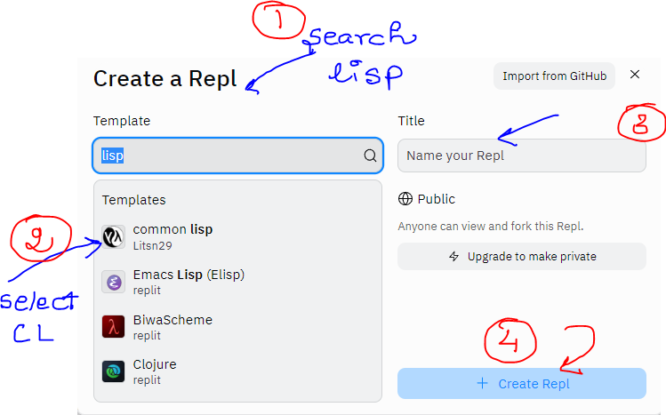
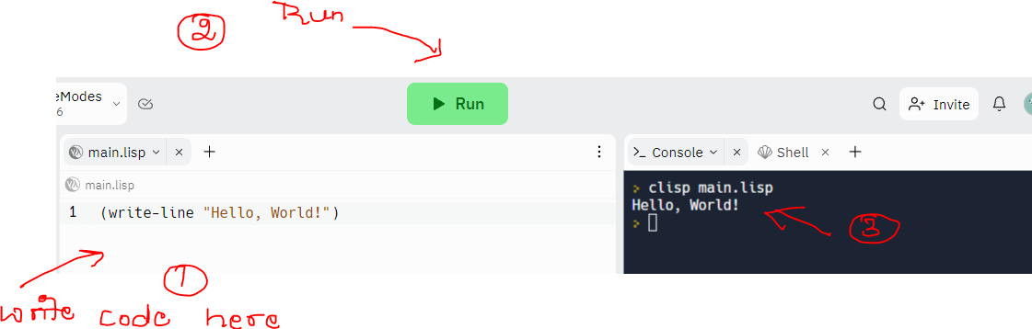
Environment
STEP 3: Create Repl
Step 4: Run your first code

Slide 32
That’s all for now!

